Slide 1

Railway Data Analysis and Forecasting
Prepared by: Youssef Mohamed Ibrahim
Group: G2
Exploring railway operations, delays, and revenue to enable informed decisions.

Slide 2

Project Overview
Objective
Tools Used
Dataset
Analyse railway operations, delays, and revenue
Power BI
Journey details
Power Query
Ticket sales
DAX
Delays and prices
Stations

Slide 3
Project Timeline
Week 1
Data Cleaning and Preprocessing
Week 2
Defining Analysis Questions and Forecasting
Week 3
Dashboard Building
Week 4
Final Presentation Preparation

Slide 4




Week 1 - Data Cleaning
Missing Values
Data Types
Replaced blanks with "No Delay"
Corrected Dates, Times, and Numbers
New Columns Created
Outcome
Month Name, Month Date, Week Number, Weekday/Weekend
Clean, structured dataset ready for analysis

Slide 5
Week 2 - Analysis Questions
Total number of rides
Total and daily revenue
Revenue per ticket class
Common departure and arrival stations
Average journey duration and delay
Forecast rides and revenue next month

Slide 6
Week 2 - Forecasting
Forecasted Rides
Forecasted Revenue
Ticket Class Demand
Methods
Estimated total rides for next month
Projected daily and total income
Predicted popularity per class
Power BI Forecast Analytics and DAX

Slide 7


Week 3 - Dashboard Building
KPI Cards
Total Rides, Revenue, Delay Times
Analysis
Revenue, sales trends, operational metrics
Delay Insights
Reasons and period distributions
Slicers
Month, Ticket Class, Journey Status

Slide 8




Key Findings
Delay Pattern
Ticket Sales
Evening period has highest delay rates
1
2
Standard Class ~70% dominant
Traffic Volume
4
3
Revenue Growth
Heaviest on weekdays
Expected ~10% increase next month

Slide 9
Challenges and Solutions
Challenges
Solutions
Incomplete data (blank delay reasons)
Clean data, replace blanks with “On Time"
Forecasting limited by data history
Tune forecasting parameters manually

Slide 10
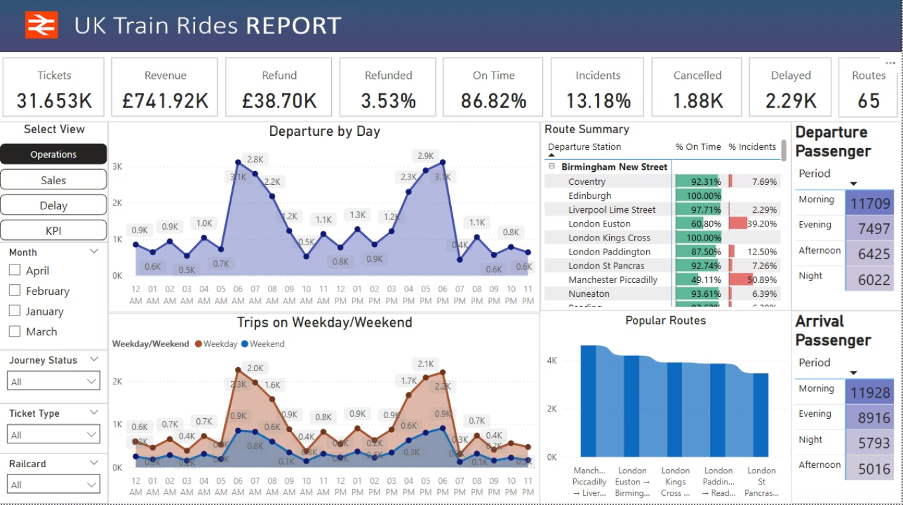

Slide 11
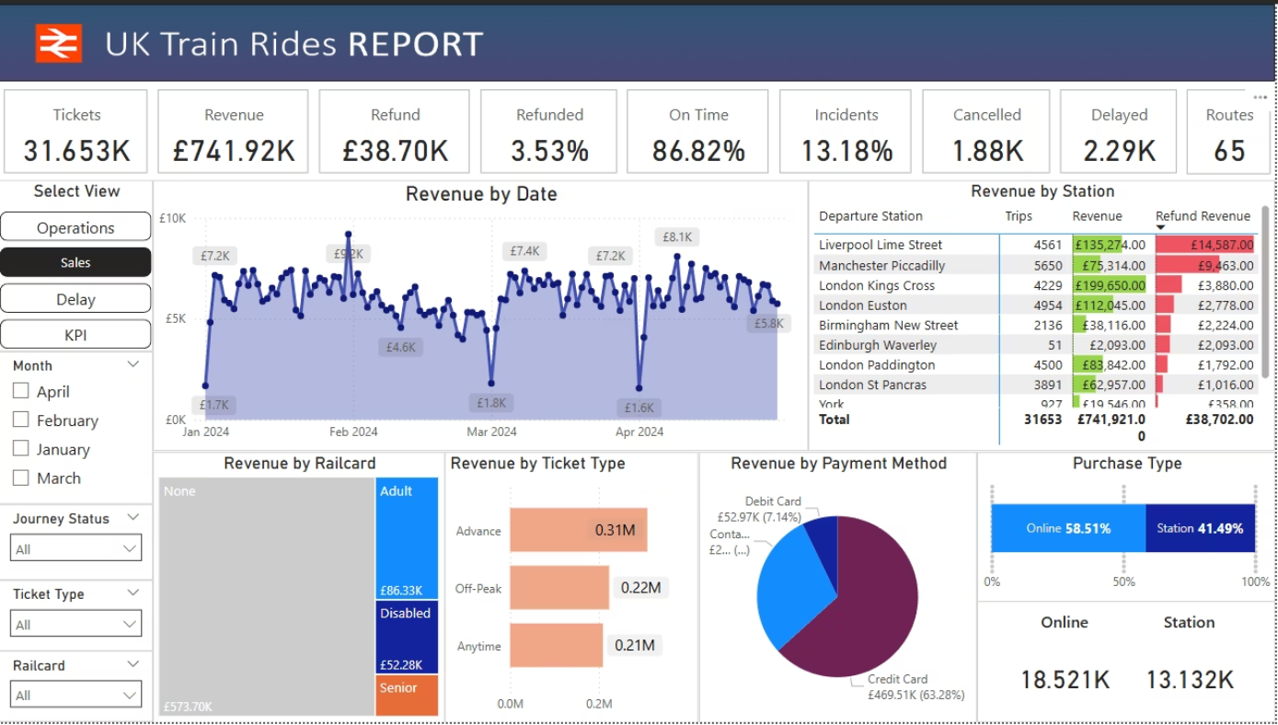

Slide 12
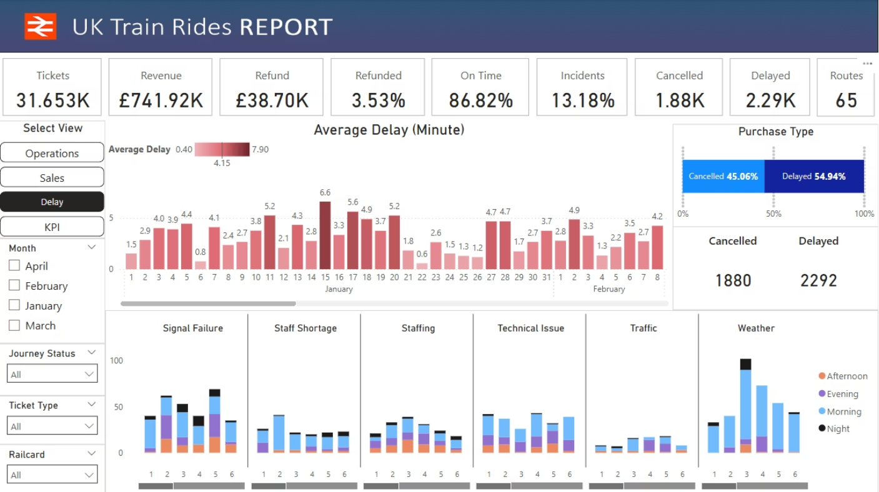

Slide 13
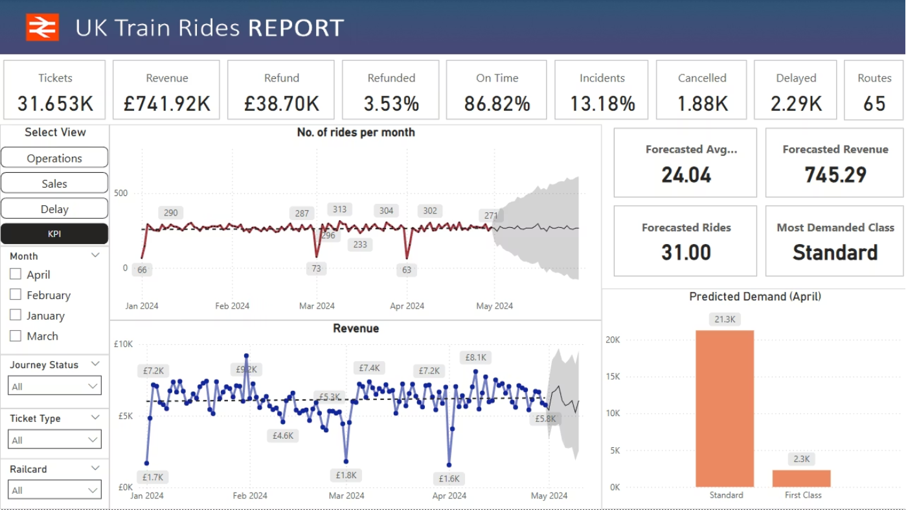

Slide 14
Thank you

